Slide 1

Scanning System and Networks

Slide 2
The Role of Scanning
Each scan type is like a piece of a larger puzzle that can be assembled to gain a clearer view of the overall target.
Ping sweep
Port scanning
Vulnerability scanning

Slide 3
Getting Started with Scanning
Network scanning is an intense and methodical process of uncovering the structure of the network and hosts on it.
The information gathered here can refine the enumeration process later.
IP addresses of live systems
Operating system versions
MAC addresses
Service information
Port data
Lists of open and closed ports

Slide 4
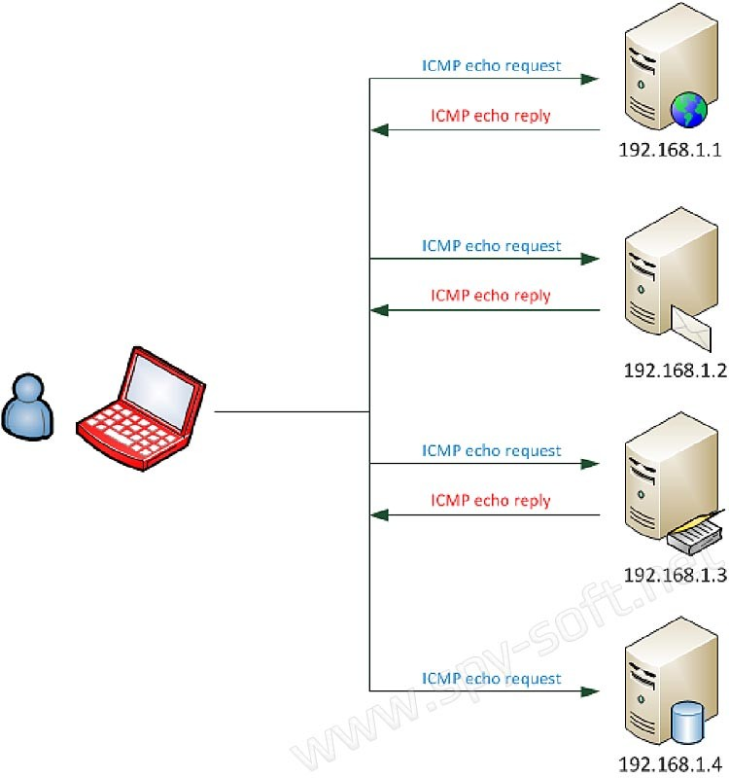
Target Up or Down
Important to locate which systems are online
Not every address in a range of IP addresses is “on”
Need to eliminate systems that are off from those that are on
Scans to locate “on” or “off” systems are called ping sweeps or ICMP scans
A quick way to check for live systems is to use the ping function to perform a ping sweep or ICMP scan. Pinging is the process of using the ping command to ascertain the status of a given system, specifically if it is responsive or not.

Slide 5
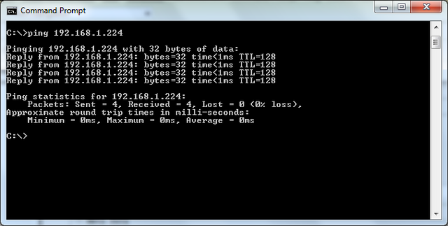
What Does a Ping Look Like?
Ping is a common network diagnostic utility
Used to diagnose network problems
Uses the Internet Control Message Protocol (ICMP)
Sends a packet to a remote system and waits for a response
If no response within a set time, the target is listed as unreachable
Present in every operating system
Ping is used diagnostically to ensure that the host computer the user is trying to reach is actually operating. Ping works by sending an Internet Control Message Protocol (ICMP) Echo Request to a specified interface on the network and waiting for a reply.

Slide 6
Angry IP Scanner
Common scanner used to perform ping scans
Can scan a range of IP addresses and their ports
Pings each address to determine whether it’s alive
Can scan a range of IP addresses extremely fast
Can save results to a file for later use

Slide 7
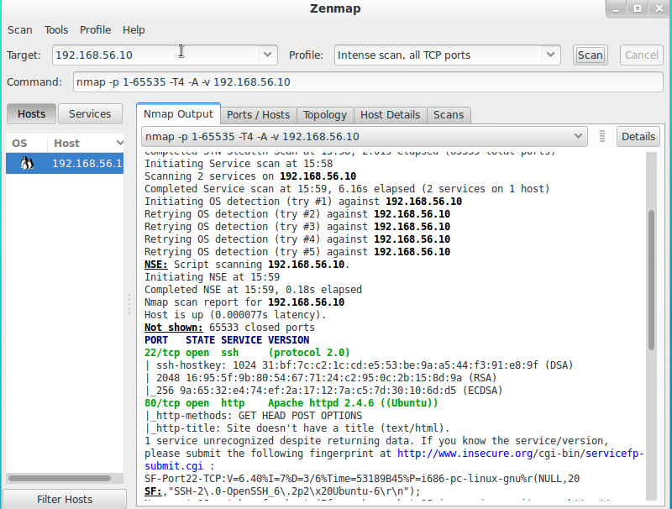
Introducing NMAP
The utility is used for everything from performing network inventory to security auditing as well as monitoring systems.
Flexible
Powerful
Portable
Easy
Free
Well documented
Supported

Slide 8
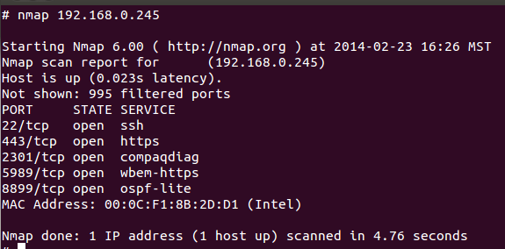
What Is a Port Scan?
Used to identify the open and closed ports on a system
A port is a virtual endpoint on a system
When combined with an IP address, they form a socket
A socket identifies which service to connect to on a system
Port scans allow an attacker to locate potential entry points
Examples are port 80 for HTTP and 21 for FTP
Port scanning has legitimate uses in managing networks, but port scanning also can be malicious in nature if someone is looking for a weakened access point to break into your computer.

Slide 9
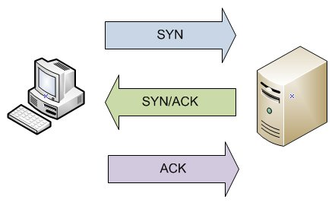
TCP and the Three-Way Handshake
TCP establishes connections and then verifies that each and every packet makes it to their destination in the right order. To accomplish this, TCP uses the three-way handshake.
Ports can be TCP or UDP.
TCP is a connection-oriented protocol.
The three-way handshake is used to establish a connection.
The completion of three-way handshake is used before sending packets.
The three-way handshake does not handle security.
TCP also provides sequence numbers for the reassembly of data.

Slide 10
User Datagram Protocol (UDP)
UDP is stateless
UDP does not make connections
Advantage is low overhead
Much like TCP, UDP sends packets
No guarantees that data will arrive at destination

Slide 11
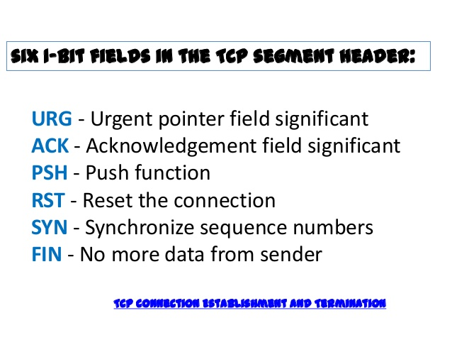
TCP Flags
SYN: Used to initiate a connection between two different hosts in order to facilitate communications
ACK: Used to acknowledge the receipt of a packet of information
URG: States that the data contained in the packet should be processed immediately
PSH: Instructs the sending system to send all buffered data immediately
FIN: Tells the remote system that no more information will be sent. In essence this is gracefully closing a connection.
RST: Represents a reset packet that is used to reset a connection.

Slide 12
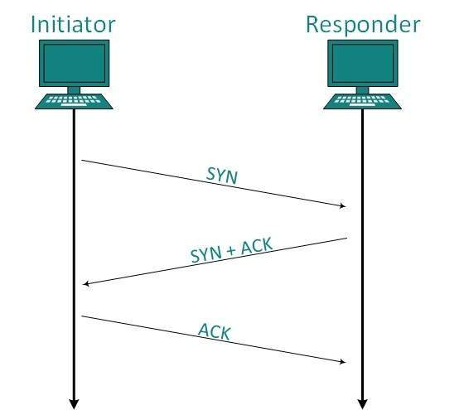
TCP Full Connect Scan
Utilizes the three-way handshake
Incomplete handshake indicates closed
Scan gives most accurate picture of port status
Drawback is scan can be easily logged
nmap –sT–v <target IP address>
Completed handshake indicates open port

Slide 13
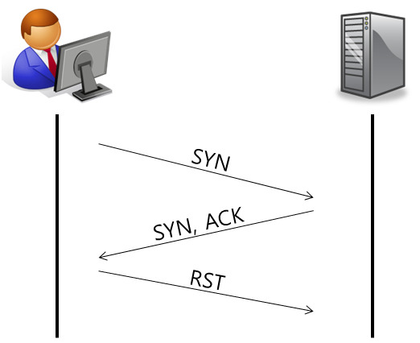
Half Open Scans
Starts like full connect scan
Scan does not complete the final step of the handshake
Benefit is scan has lower chance of being logged
Scan tends to be faster than full connect
nmap –sS –v <target IP address>

Slide 14
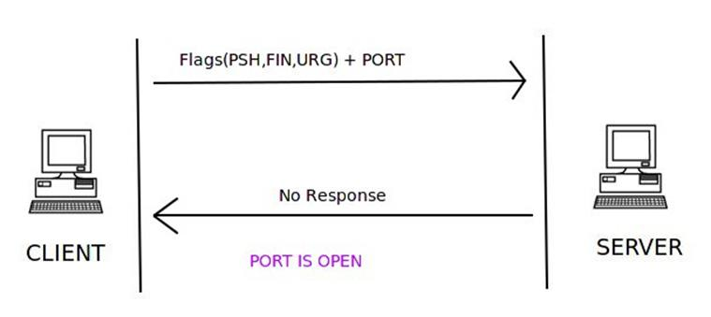
XMAS Scan
A packet is sent with PSH, URG, and FIN all set at once
Combination of flags is illogical and illegal
Some software developers do not implement TCP correctly
Does not work on most modern systems
nmap –sX –v <target IP address>

Slide 15
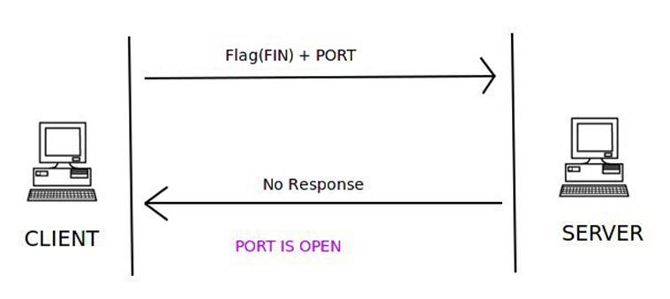
FIN Scan
Occurs when a packet is sent with the FIN flag set
Used to determine whether ports are open or closed
May not function on newer targets
Can be blocked by some firewalls

Slide 16
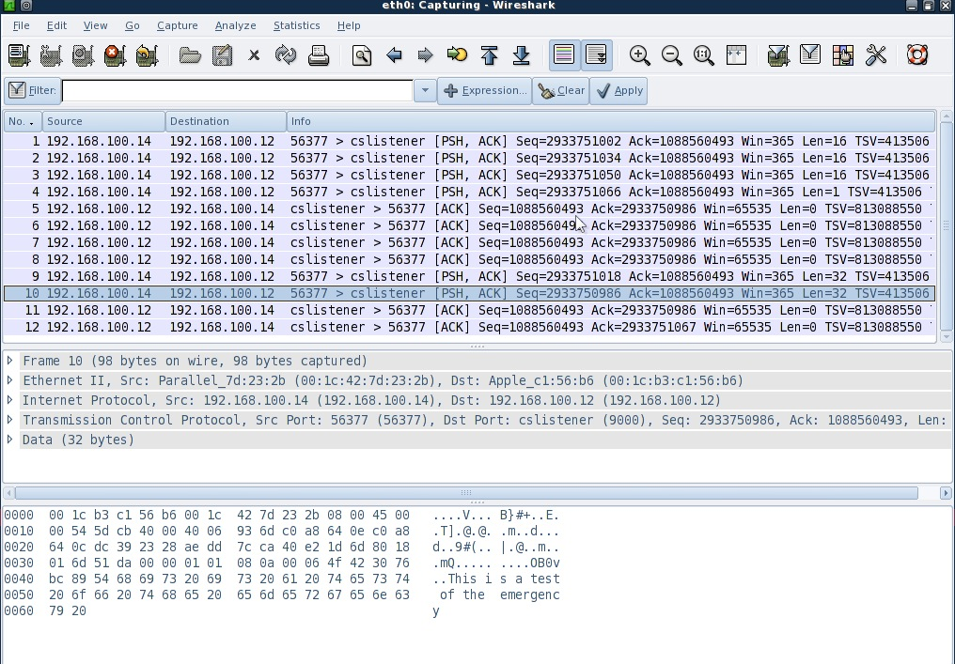
Fragmenting
Fragmenting breaks up packets
Is reassembled by target
Packets are fragmented when they exceed a network’s MTU
Fragmenting can be used to evade detection

Slide 17
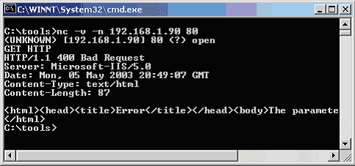
Banner Grabbing
Banner grabbing is an activity that is used to determine information about services that are being run on a remote computer.
Used to identify a system and services
Retrieves information from open ports and services
Services respond to banner grabs with application-specific information
Can use Telnet of SSH to perform this task

Slide 18
Vulnerability Scanners
Used to identify known vulnerabilities
Not typically stealthy
Generally performed by automated means
May only catch problems that are already known
Not a good choice if trying to simulate an attack
These tools function by checking coding, ports, variables, banners, and many other potential problems areas looking for issues.

Slide 19
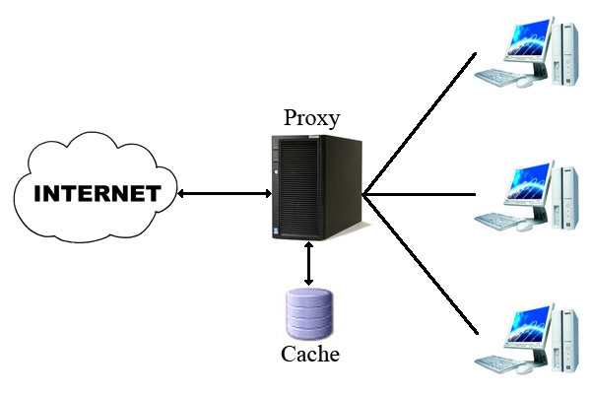
Providing Cover with Proxies
A proxy can lower chances of detection
Routes traffic through a machine acting as proxy
Can perform content filtering
Can provide anonymizing services

Slide 20
Summary
Scanning requires a good understanding of networking technologies.
Enumeration follows scanning.
Enumeration seeks to reveal information from a system.
Enumeration is an active measure.
Information can include usernames, group information, printer data, and other data.

